Slide 1
SEEM3510 Tutorial: Summary of the basics in Human Computer Interaction (HCI)
Instructor: Professor Helen Meng, Professor Philip Fu
TA: Yuejiao WANG

Slide 2
Outline
Development of Human Computer Interaction (HCI)
Usability Requirements (UR)
Usability Measures
Usage context
Universal usability
Conclusion

Slide 3
I. Development of HCI
1945: Bush—As We May Think—’Memex’
1962: Ivan—Sketchpad
1963: Douglas—Mouse
1983: ACM SIGCHI definition
1981: Xerox Star
HCI
Human
Interaction
Computer

Slide 4
HCI: A multidisciplinary field
Psychologists: who study the users
Computer Scientists: study the computers & interface
Instructional and Graphic Designers: design and implement UI components and artworks
Technical Writers: document writing, e.g., writing manuals and tutorials, is an integrated and key component of any good interface
Human Factors and Ergonomics Experts: design ergonomic interfaces
Sociologists: social interfaces, e.g. Facebook, Twitter, WhatsApp

Slide 5
User interfaces (UIs) in daily lives
Transportation: path planning for a trip
Decision support: a doctor’s diagnosis and treatment
Education and training: MIT / Stanford Open Courses
Entertainment: music player, game console, etc.
Good UI is vital in HCI

Slide 6
II. Usability Requirements (UR)
Four Goals of UR:
Ascertain
Ascertain the user’s needs
Ensure
Ensure proper reliability
Promote
Promote appropriate standardization, integration, consistency, and portability
Complete
Complete projects on schedule and within budget
Usability requires project management, careful attention to requirements analysis, and testing for clearly defined objectives, which can be used to ensure that a product is easy for deployment.

Slide 7
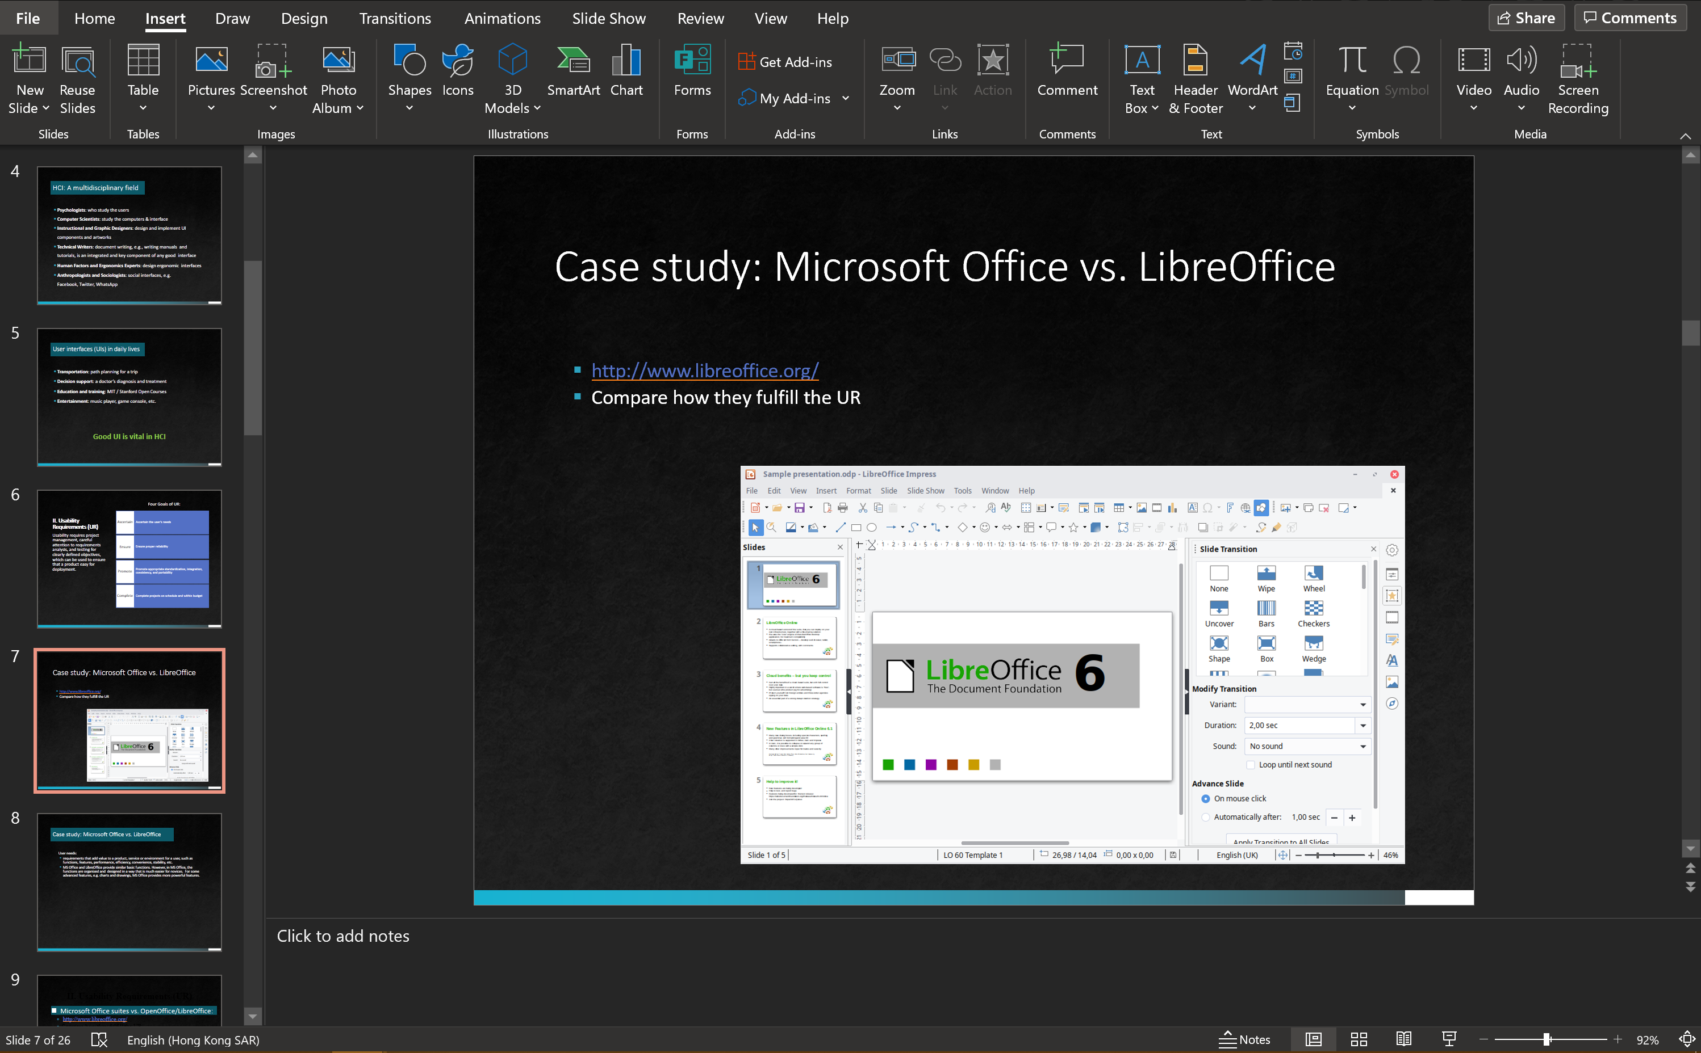
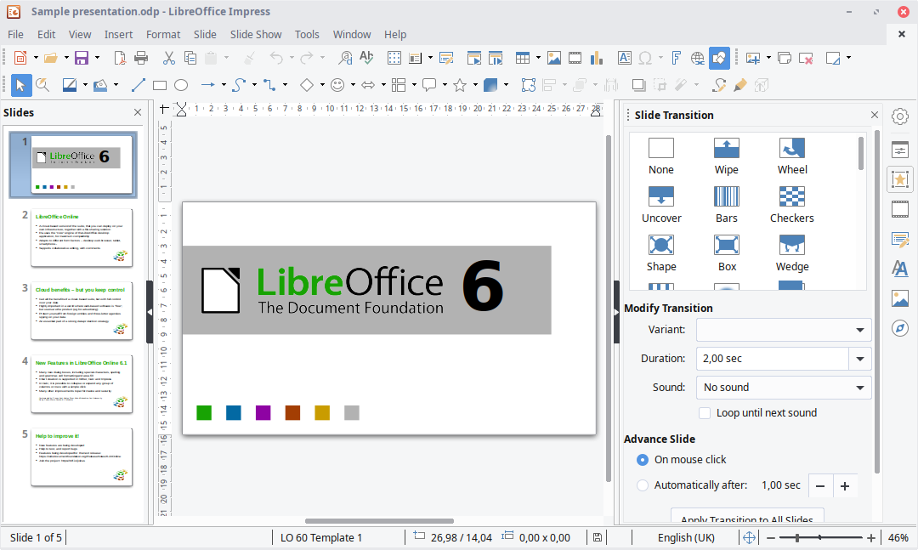
Case study: Microsoft Office vs. LibreOffice
Microsoft PowerPoint
LibreOffice Impress (http://www.libreoffice.org/)
Compare how they fulfill the UR

Slide 8
Case study: Microsoft Office vs. LibreOffice
User needs:
requirements that add value to a product, service or environment for a user, such as functions, features, performance, efficiency, convenience, stability, etc.
MS Office and LibreOffice provide similar basic functions. However, in MS Office, the functions are organized and designed in a way that is much easier for novices. For some advanced features, e.g. charts and drawings, MS Office provides more powerful features.

Slide 9
Case study: Microsoft Office vs. LibreOffice
Reliability:
All actions that the user takes must reflect appropriate results; presented information must be accurate. If you do not provide this kind of reliability, users will quickly loose trust in your application and stop using it
MS Office is more reliable: fewer errors
LibreOffice have more “bugs” and sometimes are not responsive

Slide 10
Case study: Microsoft Office vs. LibreOffice
Standardization etc.:
MS Office has standardized, integrated, and consistent designs within the Office suite and other parts of the Windows operating system. However, for business reasons, it only has Windows and Mac version. But LibreOffice is available in Windows, Mac, and Linux. Besides, now that the web is so important, MS also provides web version of Office, which is not contained in LibreOffice.

Slide 11
Case study: Microsoft Office vs. LibreOffice
Complete projects on schedule and within budget:
A general goal should be considered for all software projects
Sometimes UI designers forget about this goal, however it is as crucial to UI design as it is to other parts of the software development process
Every delay or increase in costs will affect your project in one way or the other (e.g., the customers may switch from MS office to LibreOffice if the bugs of MS office are not fixed on schedule)

Slide 12
Case study: Microsoft Office vs. LibreOffice
Overall:
We would like to conclude that compared with LibreOffice, MS Office has advantage in various aspects of usability (except that it is expensive and missing in Linux).

Slide 13
III. Usability Measures
Five human factors central to usability evaluation:
Time to learn
Speed of performance
Rate of errors by users
Retention over time
Subjective satisfaction

Slide 14
Example: MS office Word
Time to learn
Time for an average user (aka, novice) to learn how to use Word to type a normal document (e.g., Letter or Report), without resorting to advanced or complex features.
Speed of performance
We first need to identify what are the benchmark tasks by user study. These tasks can be divided into easy (e.g., just type words) or complex (e.g. using charts, letter merging, etc.) tasks. Then the user’s speed to finish such tasks can be measured.

Slide 15
Example: MS office Word
Rate of errors by users
Measure the types and frequency of errors made by users when using Word.
Retention over time
Study what features are remembered by the users after various timespans. E.g., we can generate such a table that one axis is the elapsed time (1 hour, 1 day, 1 week, etc.), the other axis is the features (set font size, set justification, etc.).
Subjective satisfaction
User’s feedback of their feeling after using the product (e.g., Word), which can be obtained by conducting subjective evaluation test.

Slide 16
IV. Usage context
Consumer electronics, e‐commerce, social media, daily activities, e.g. Room2Room (MS), iphone.
Games and entertainment, e.g. AR interactive games
Professional environments, e.g. MRI used to generate images of the organs in the body, ICU for new born babies.
Exploratory, creative and collaborative interface, e.g. Information Search (Google)
etc.

Slide 17
V. Universal usability
The diversity of users makes universal usability a very challenging task:
Physical abilities and physical workplaces
Cognitive and Perceptual abilities
Personality differences
Cultural and International Diversity
Users with Disabilities
Considerations for Elderly
Considerations for Children
Accommodating hardware and software diversity

Slide 18
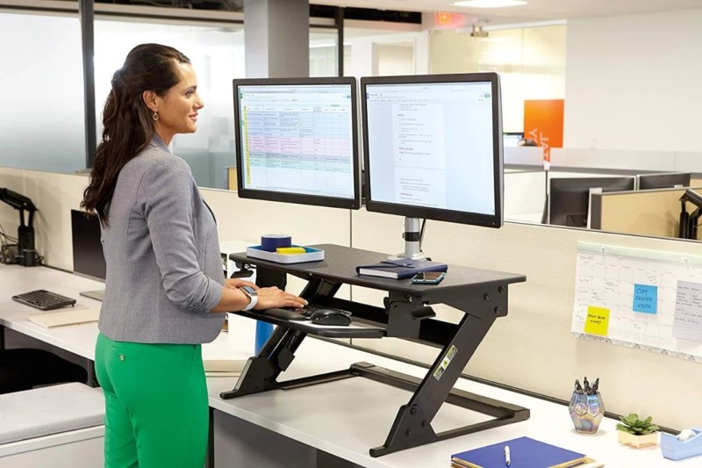
Universal usability
Physical abilities and physical workplaces
Physical abilities vary from person to person in terms of human dimensions:
Male/female, young/adult, European/Asian, tall/short
Size: head, mouth, nose, neck, shoulder, chest, arm, etc.
All these differences lead to different users’ needs.
Design of physical workplaces should accommodate various physical ability settings

Slide 19
Universal usability
Cognitive and Perceptual abilities
Definition: Perception is the ability to capture, process, and actively make sense of the information that our senses receive, such as vision, touch, hearing and hand control. It is the cognitive process that makes it possible to interpret our surroundings with the stimuli that we receive throughout sensory organs. [*]
Affected by many factors
Arousal and vigilance
Fatigue and sleep deprivation
…
Note: Background experience and knowledge in the task domain and the interface domain play key roles in learning and performance. Interface design should consider different people with various cognitive and perceptual abilities to facilitate the end-users.
[*] Brown, Ted, et al. "Relationship of cognitive and perceptual abilities to functional independence in adults who have had a stroke." Occupational therapy international 20.1 (2013): 11-22.

Slide 20
Universal usability
Personality differences
Myers-Briggs Type Indicator (MBTI)
extroversion vs. introversion
sensing vs. intuition
perceptive vs. judging
feeling vs. thinking
Different people with different personalities have various responds to different design of the interface
To target a specific population, the personality of the certain population should be considered. E.g., the Sims, social games, cooking games, Candy Crush games are more attractive to kids.

Slide 21
Universal usability
Cultural and International Diversity
People coming from different cultural background and countries have different believes, behaviors, habits and values, etc.
Example: Designing for cell phones can open the door to a wider audience, e.g. in developing countries where:
feature phones often are the only way to access the internet
literacy may be an issue
users have very low monthly limits on the data volume they can use

Slide 22
Universal usability
Users with Disabilities
Early planning for the disable should be implemented, e.g., speech-aided technologies.
Example: avoid side effect[*].
Side effects are actions that occur as the result of user actions that do not seem to the user to be related to the primary goal of the action. For instance, when starting a program that changes system configurations (such as screen and sound settings) it should change them back when the program is not being used.
Side effects should be avoided because they cause particular problems for disabled users who may have difficulty detecting or correcting certain types of side effects.
[*] http://www.usabilityfirst.com/about-usability/accessibility/principles-of-accessible-and-universal-design/

Slide 23
Universal usability
Considerations for Elderly
The elderly is a large and special group that require much more attention.
Example: Web design[*].
Color: Maximize the contrast between foreground and background colors.
Font: adjustable to satisfy different requirements
Navigation mechanisms: Avoid a very deep hierarchy, Provide information about the general layout of a site.
Sound: Use lower frequency tones
Content: provide text equivalent to auditory and visual content
Layout & Style: Clear organization of content, Paragraph alignment
[*] http://www.co-bw.com/DMS_Web_the_elderly_on_the_web.htm

Slide 24
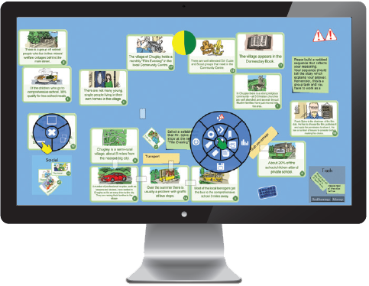
Universal usability
Considerations for Children
Entertainment and education are main purposes .
Consider the following scenario: Using Digital Mysteries on a tablet, two elementary school children work together to read information slips, group them and create a sequence to give an answer to the question “Who killed King Ted?” The following considerations have been considered: (www.reflectivethinking.com)
The blue pop-up pie menu allows the selection of tools.
A larger tabletop version allows larger groups to collaborate.

Slide 25
Universal usability
Accommodating hardware and software diversity
Faced with three main challenges
Internet interaction: Producing satisfying and effective Internet interaction on high‐speed (broadband) and slower (dial‐up and some wireless) connections
Display size: Responsive design enabling access to web services from large displays to smaller mobile devices
Cross-language conversion: Supporting easy maintenance or automatic conversion to multiple languages

Slide 26
Recap
Development of Human Computer Interaction (HCI)
Usability Requirements (UR)
Usability Measures
Usage context
Universal usability

Slide 27
Thank you

